Slide 1
Damage Detection on Bearing
Condition Monitoring

Slide 2
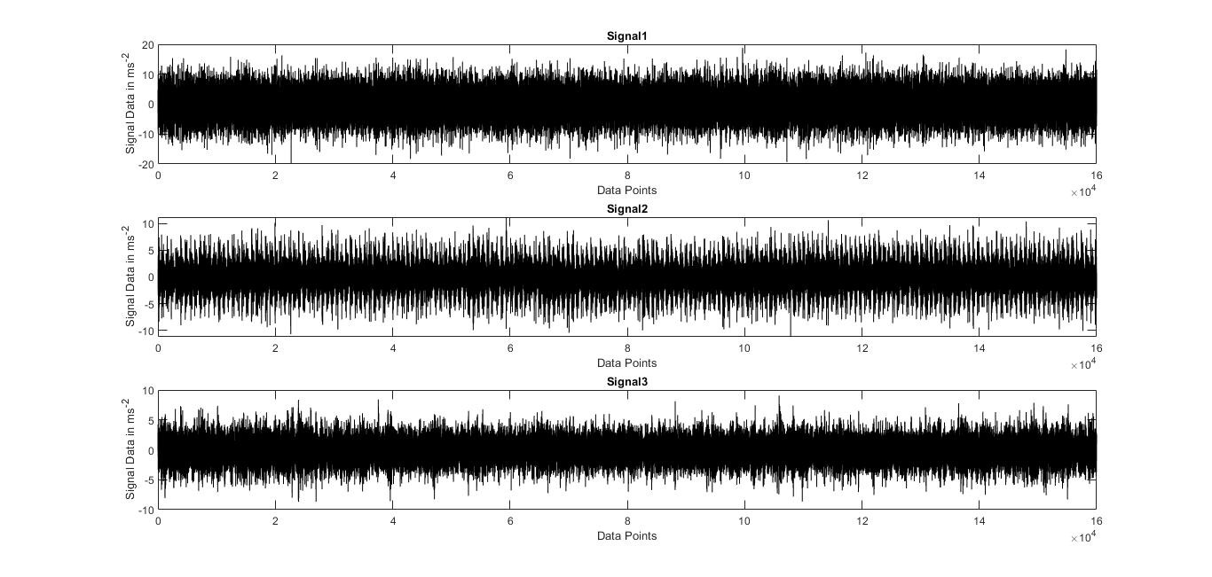
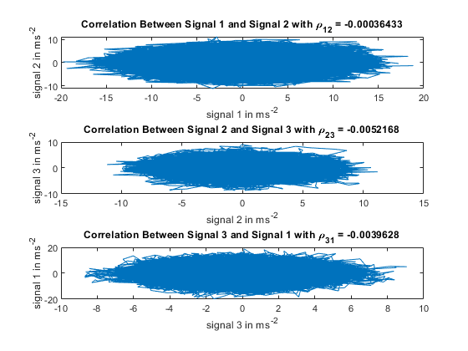
1. Time Domain Analyis 1.1 Relation Between the Signals
Are these related?
No
Operating Conditions and Time of measurement?
Unknown

Slide 3

1. Time Domain Analyis 1.1 Relation Between the Signals
Are these related?
No
Operating Conditions and Time of measurement?
Unknown

Slide 4
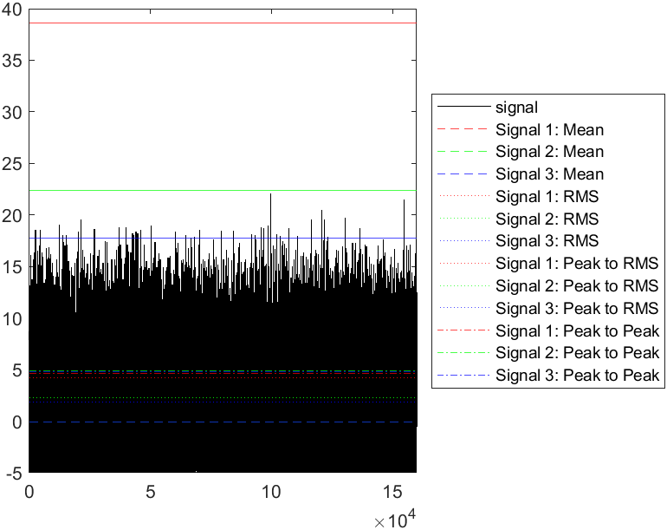
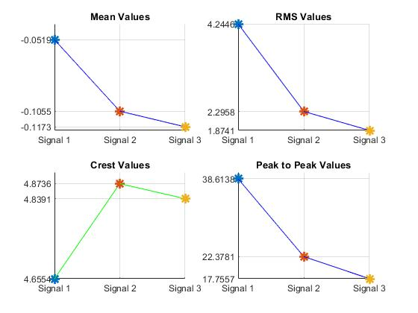
1.2 Machine Features
Change in these Statistical Values give the change detection.
On comparing, Signal 1‘s features have more change/ difference from other 2 signals.

Slide 5
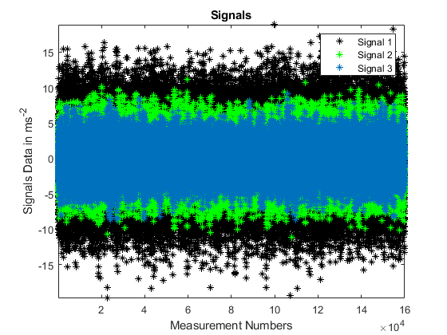
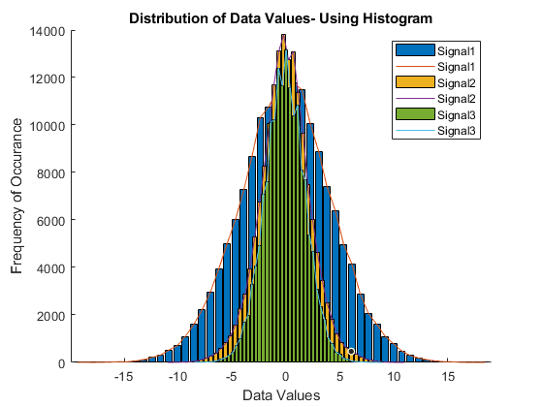
1.3 Data Distribution- Histogram
This gives us a way of viewing general distribution for a set of values.
More data distribution for Signal 1.
Histogram

Slide 6
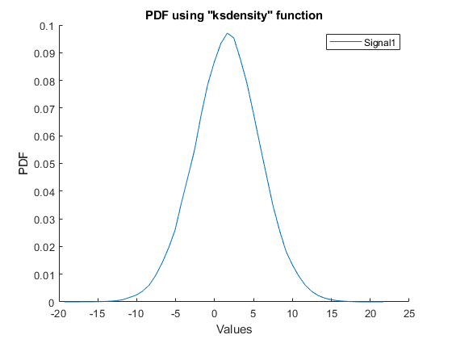
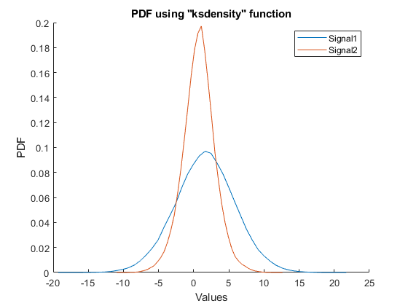
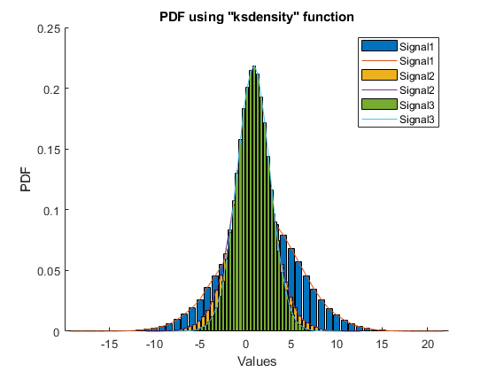
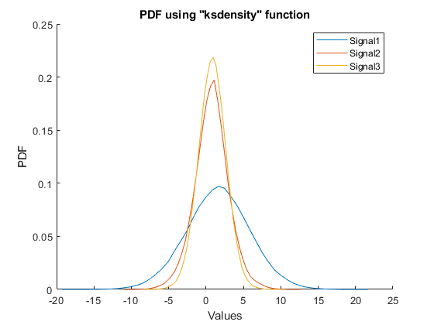
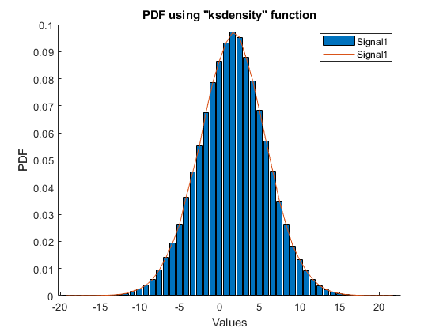
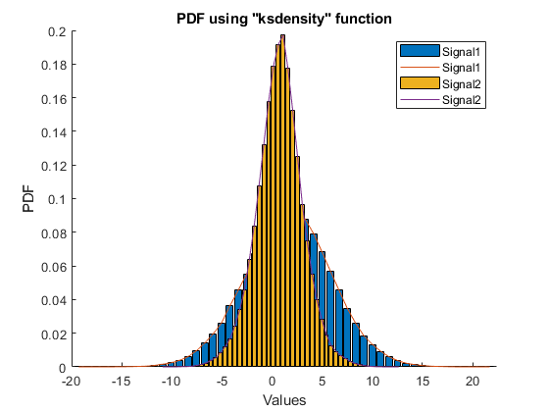
1.4 Probabilities- PDF
This shows that Signal 1 has more data values those are leaned towards damages.

Slide 7
1.4 Probabilities- PDF
This shows that Signal 1 has more data values those are leaned towards damages.

Slide 8
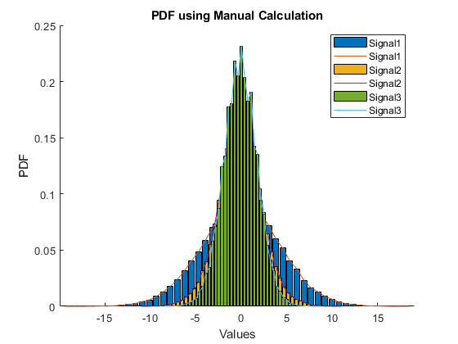
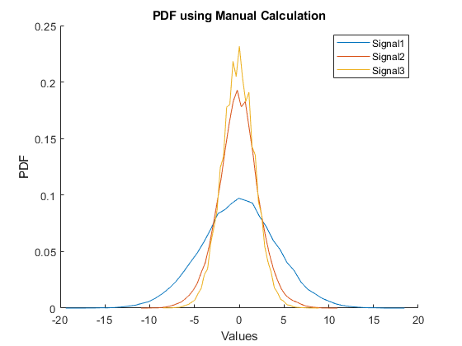
1.5 Probabilities- PDF
2 of the Signals have more similar curve than the Signal 1.
So it is clear that Signal 1 is the damged Signal.

Slide 9
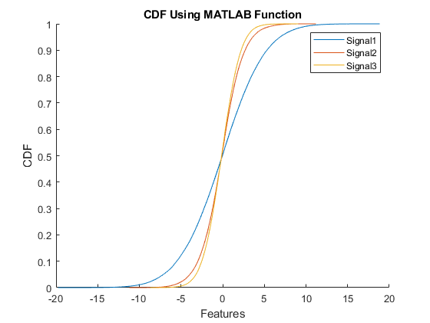

1.5 Probabilities- CDF
bhdbhbdhd

Slide 10
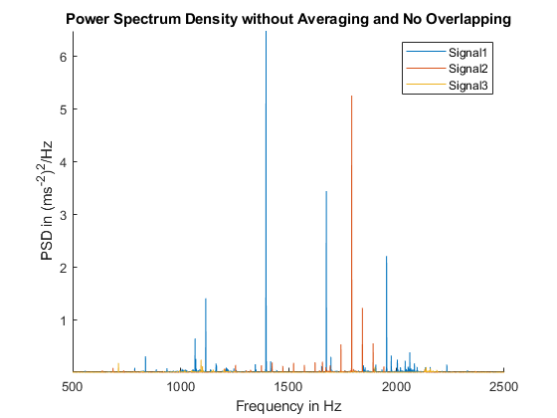
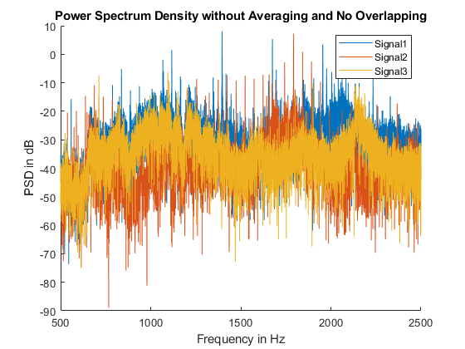
2. Frequency Domain Analyis 2.1 Power Spectral Density Using Periodograms
No Segment formation, No Overlapping and Without Averaging.

Slide 11
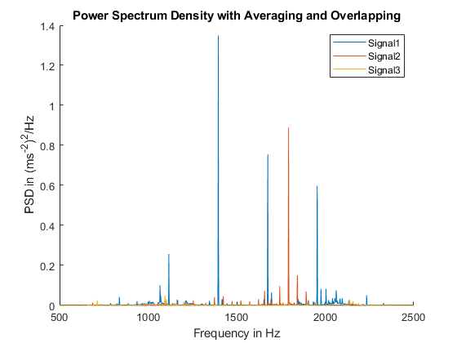
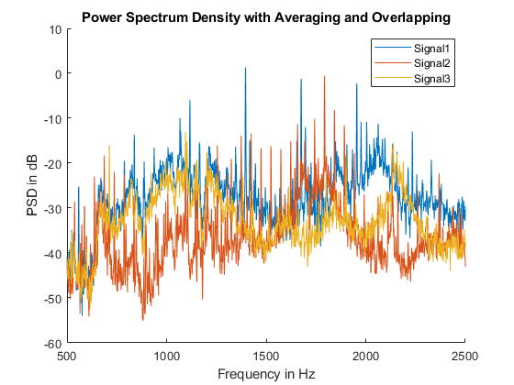
2.2 PSD with Overlapping and Averaring
Number of Segments formation by chosing proper Window.
With Overlapping and With Averaging.
Notes:
Why the HT ?

Slide 12
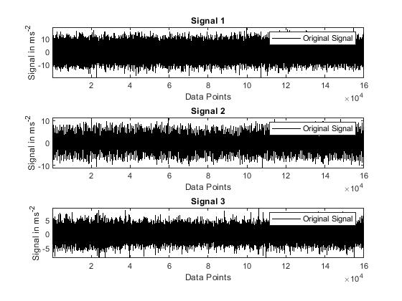
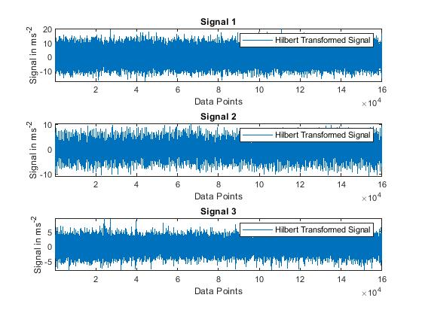
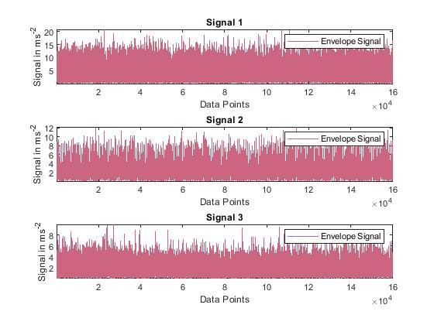
2.3 Hilbert Transformation and Envelope Spectra
Evelope Signal

Slide 13


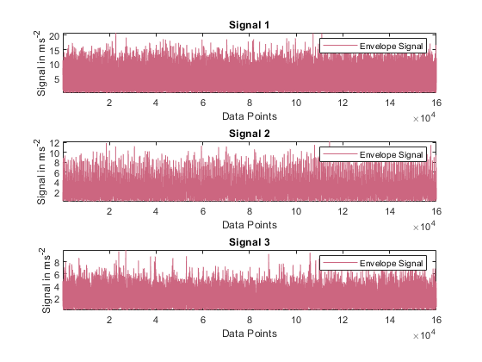
2.3 Hilbert Transformation and Envelope Spectra
Evelope Signal
+j

Slide 14
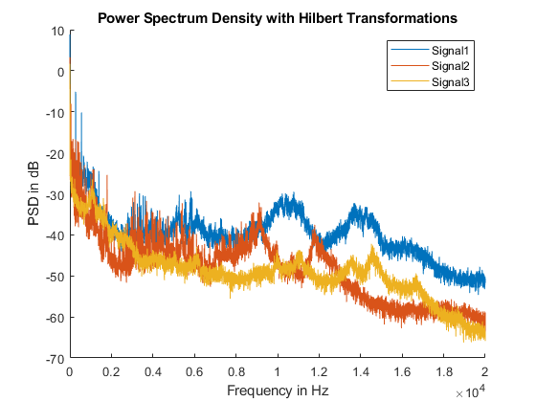
2.3 PSD for Envelope Signal
Envelope
sdfsdfsf

Slide 15
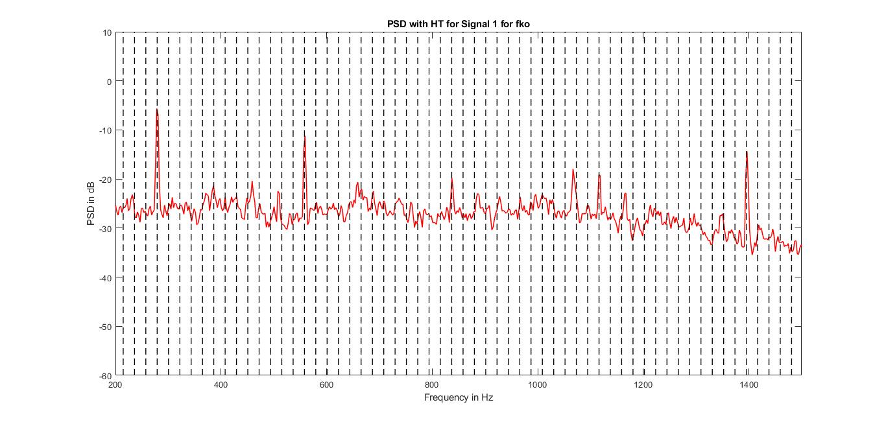
2.4 Type of Damage
fko
Outer Race roll over frequency and its higher harmnics

Slide 16
2.4 Type of Damage
fko
Outer Race roll over frequency and its higher harmnics

Slide 17
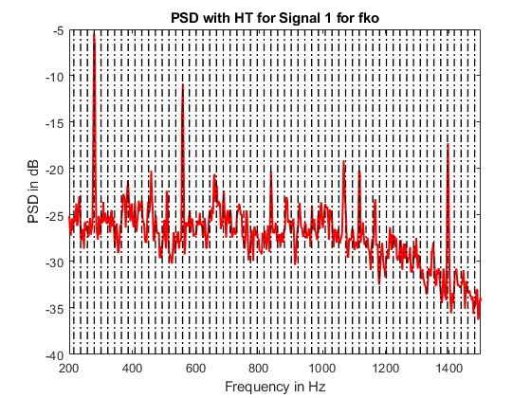
2.4 Type of Damage
Outer Race roll over frequency and its higher harmnics

Slide 18
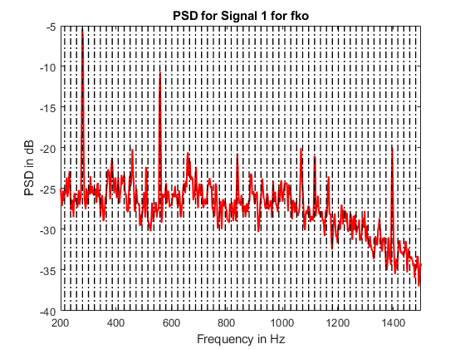
2.4 Type of Damage
Outer Race roll over frequency and its higher harmnics

Slide 19
2.5 Conclusion/ Result
Damaged Signal?
Signal 1
Type of Damage?
Outer Race Roll Over Frequency

